Slide 1

COURT CASE HANDLING SYSTEM(CCHS)
Group No: 1
A.A.T.G.Abeysinghe 2014CS001
Devanarayana.S. 2014CS022
K.C.Edirisinghe 2014CS029
D.T.Fernando 2014CS034
K.Kirishjajini 2014IS043
H.N.A.Nilakshi 2014IS056
Supervisor- Dr. D. N. Ranasinghe
Mentor- Mr. R. N. Rajapakse
Client- Registrar of Colombo District Courts

Slide 2
Project Scope & Requirements Catered

Slide 3
Introduction
Colombo District Court handles civil cases.
Civil Cases
Money Related
Land Cases
Family Problems

Slide 4

Money Related Cases
Money related cases –
a large number
most important type
complicated procedure
Currently the process takes place manually
CCHS was developed for the court staff

Slide 5
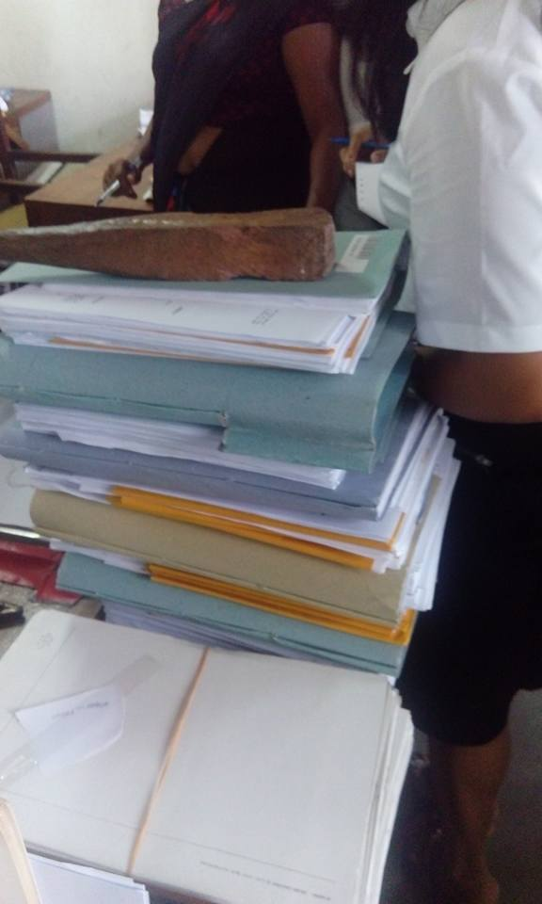
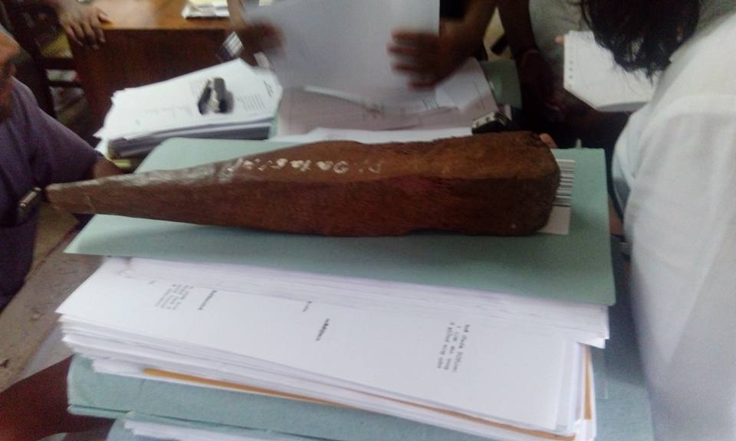
Reasons for Automation
Currently, the process takes place manually
Large number of case files
Increasing number of court cases
Difficult to find case files
Case file loss at unexpected situations
Time consuming and difficult report preparation

Slide 6


Flow of activities after Automation
Case Registration
Stamp Duty Process
Fiscal could not handover summons
Summon Serving Process
Serve DS Summons
Fiscal handed over summons
Roll Court Proceedings
Defendant Appears
B
No
Yes
A

Slide 7


B
Record Exparte judgment
Decree process
Inquiry process
Inquiry Made
NO
Yes
Inquiry Accepted
C
YES
NO
Cease Assets

Slide 8


A
Roll court Normal Proceedings
Bench proceeding
C
Next hearing date
Case result
Final decision given
Finalize Case

Slide 9
Scope of Project
Case Registration
Case Registration
Defendant Submission
Stamp Duty Process
Retrieve Case Details
Summon Serving Process
Summon Serving Process
Roll Court Proceeding
Handle Fiscal Reports
Case Calling Process
Roll Court Normal
CCHS
Decree Process
Bench Proceeding
DS Process
Inquiry Process
Finalize Case
Assets Ceasing Process
Report Generation
Register New User
User Registration
Edit Profile and Reset Password
Database Backup
Notes:
We will explain about each component as we go..

Slide 10

Functional Requirements
1. Case Registration
2. Issuing Case Number
3. Calculate Stamp Duty for a case.
4. Issue Stamp Duty Receipt
5. Serve Summons (Print Outs)
6. Handle Fiscal Reports Details
7. Handle Ex party judgments
8. Decree preparation
9. Handle Inquiries
10. Update case details e.g. Next hearing date, Decision
11. Handle Ceasing of assets
12. Registrar finishes the case
13. Prepare Reports
14. Record defendant details per a case
15. Retrieve case details
16. User Registration
17. Take backup of database

Slide 11
Non-Functional Requirements
Security
User friendliness
Usability
Performance
Accuracy
Free and Open Source software
Disaster Recovery

Slide 12
System Analysis & Design

Slide 13
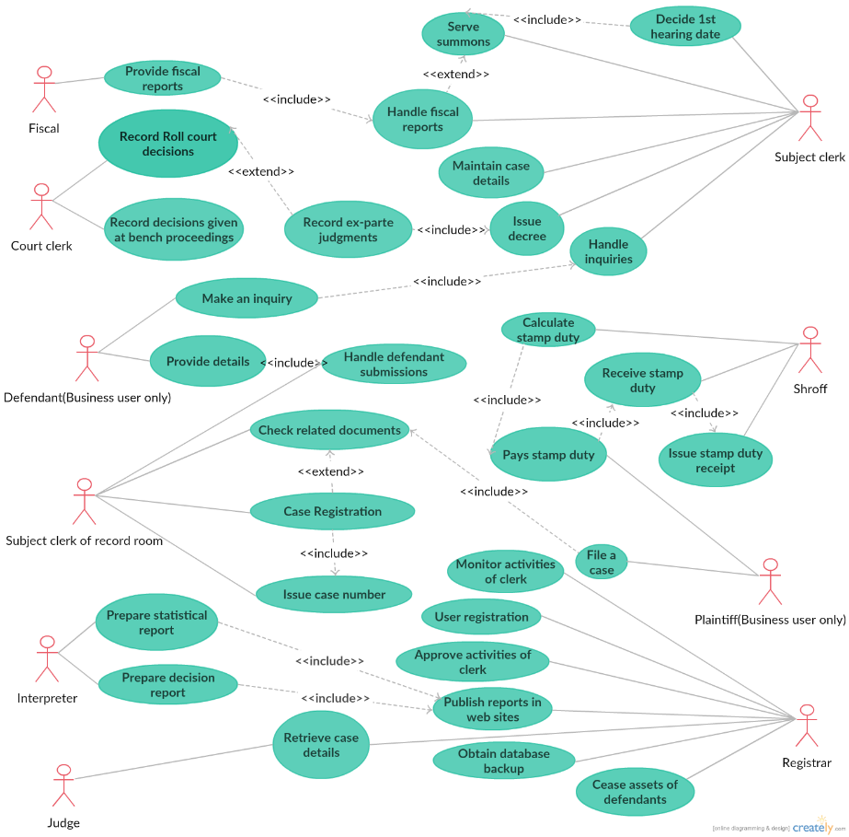

Slide 14
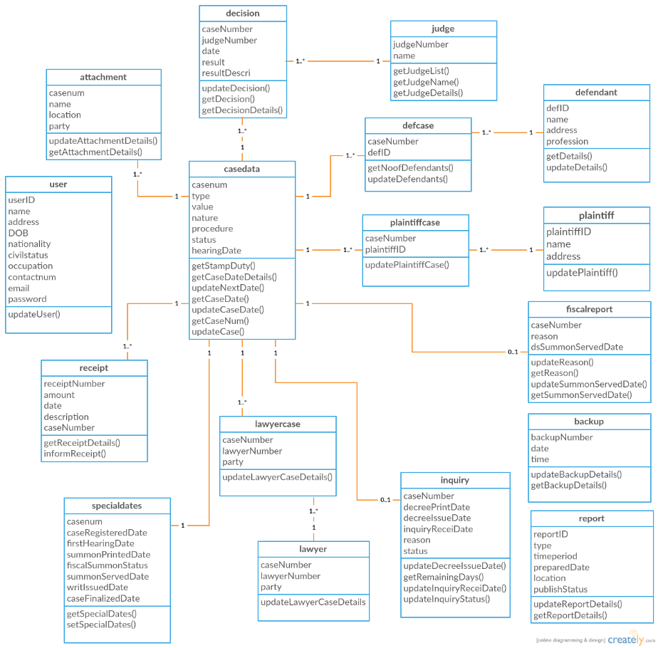

Slide 15
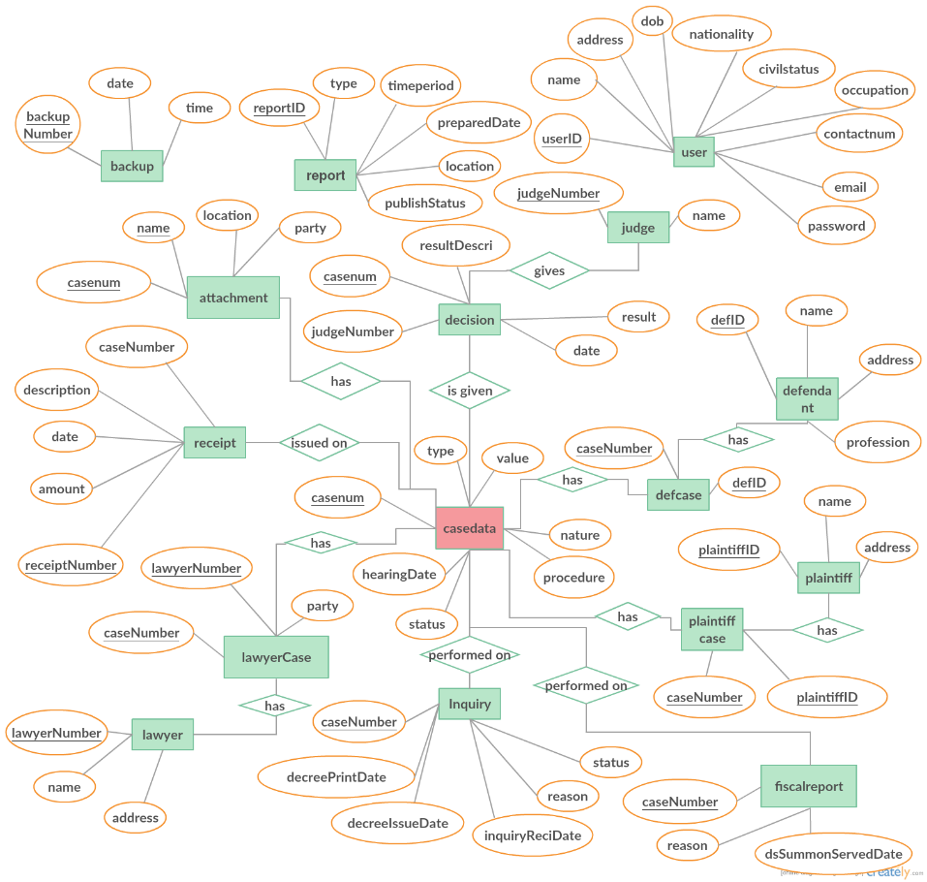

Slide 16
System Architecture

Slide 17
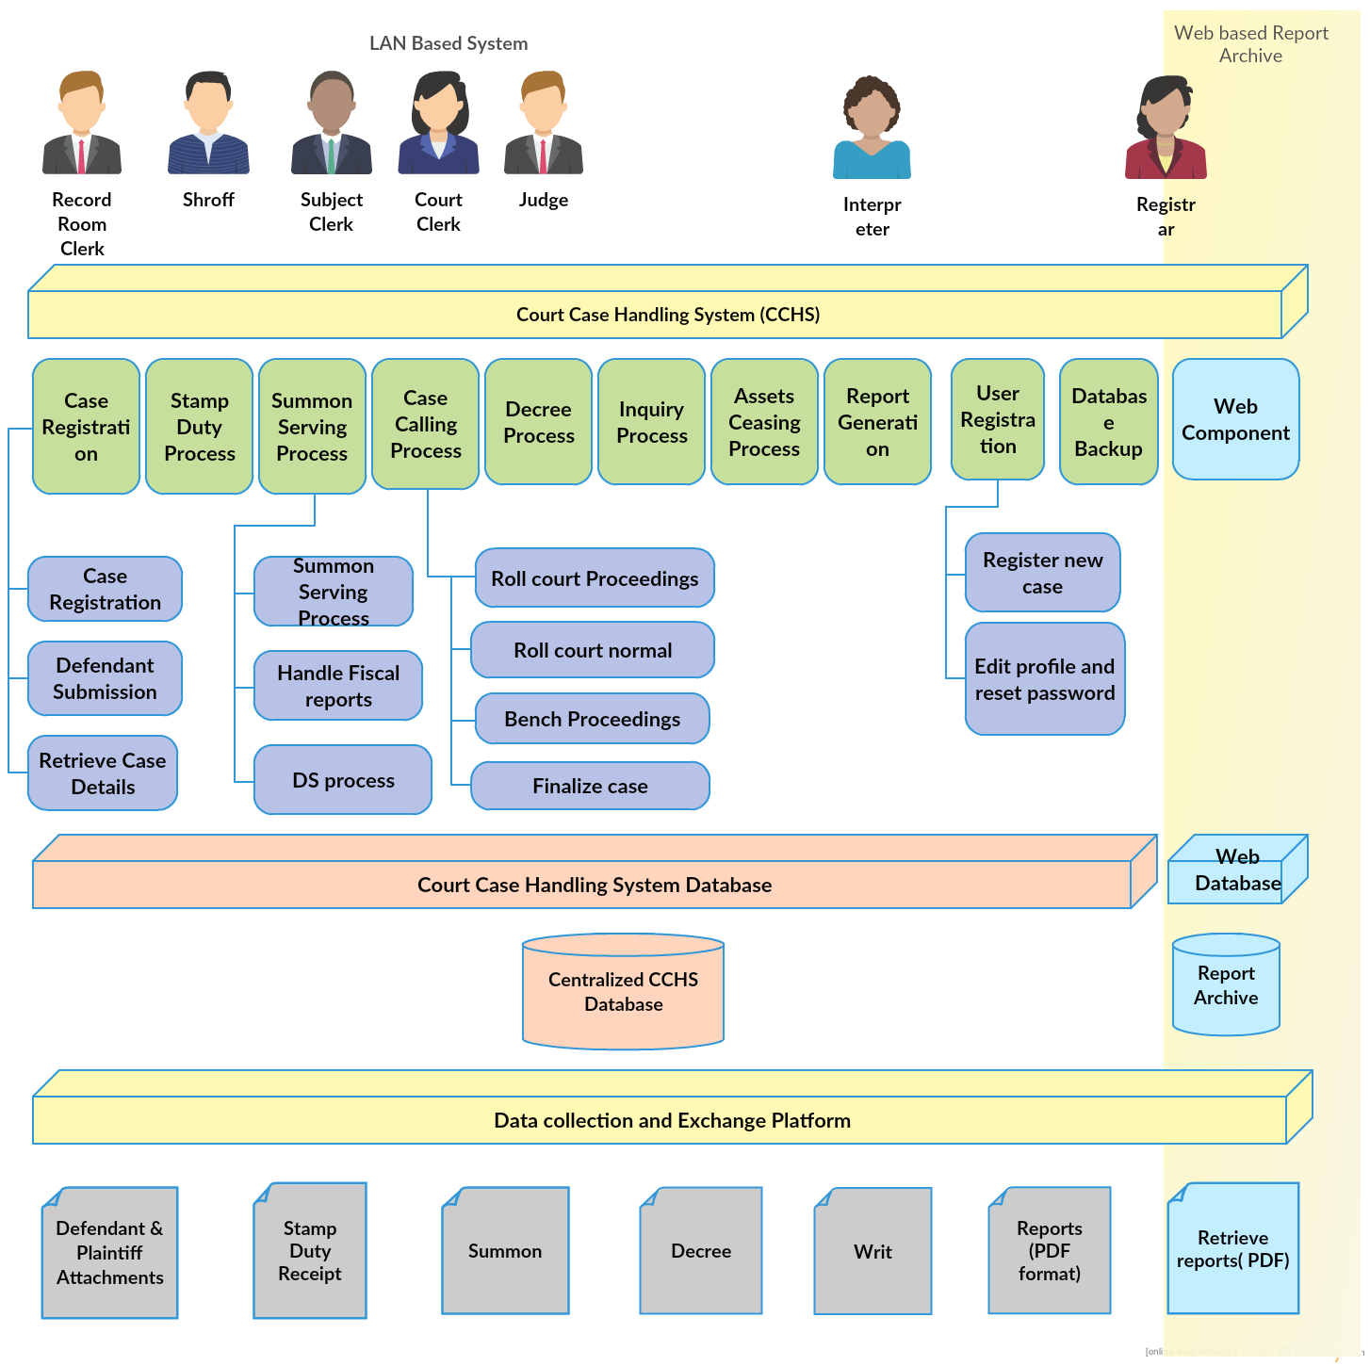

Slide 18
Usability & User Experience

Slide 19
CCHS will be used by court staff consisting of non-technical people.
Simplified interfaces
Main interface for each user
Any action could be performed in minimum number of steps
Usability: - The system should be usable by court staff with minimal training.
User manual
User training

Slide 20
Testing

Slide 21
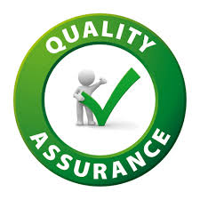

System Testing Approaches
Manual Testing:-
Alpha testing
Black box testing
Glass box testing
Integration testing
Unit testing
Acceptance testing
Interface testing
System testing
Automated Testing:-
Test Scripts using TestNG
Test Documentation

Slide 22
Overall System Completeness

Slide 23
Software Quality
Software Quality
Software functional quality
Software structural quality
How well system caters to the problem
How good the system will be performing
Security:-
Tampering Hash
Activity Log
Validation
Robustness
Maintainability

Slide 24
Technical Exposure

Slide 25


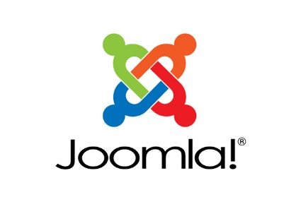


Technologies used to develop CCHS
Development :- JavaSE using NetBeans
DBMS :- MySQL
Report Generation :- Jasper Reports
Version Controlling :- GitHub
https://github.com/DuneeshaFernando/Court-Case-Handling-System
Development of web based report archive:- Joomla
Automated Testing :- TestNG

Slide 26
Why did we select JavaSE?
We are developing the software for the use of court staff
Outsiders(plaintiffs ad defendants) should not be given access to the system
Therefore this is developed as a LAN based system.
Access for the staff is not given through internet but through LAN based connection.
Provides high-level classes that are used for
Networking
Security
Database access
Graphical user interface (GUI) development

Slide 27
Theoretical & Technical Knowledge Gained
Requirements Gathering Methodologies
Feasibility Study
System Analysis & Design
User Interface design & development
System development using Java
System Testing(Manual & Automated)
Compilation of Test Documentation
User training & compilation of user manual

Slide 28


